Slide 1
New Energy Technology and Market Intelligence
North America
Chris Dass Patacsil

Slide 2
What is BloombergNEF?

Slide 3
Clean energy research for
North American clients
<<< Global | Local >>>
Technology, Manufacturing & Trade
  Technology advancements and trends
  Solar and wind equipment price indices
  Tier 1 PV Module Maker list and bankability survey
  Module, inverter, turbine, O&M, EPC industry updates and market share
  Manufacturer and developer profiles
  Global PV shipment index
Clean Energy Demand
  Residual RPS demand
  Utility RFPs and competitive solicitation
  Utility IRP and rate-basing activity
  Solar + storage opportunities
  Corporate clean energy procurement
  Community choice aggregation
  City and state procurement
Policy Turbulence and Transition
  Phase-out of the federal tax credits
  Trade wars and tariffs
  Impact of corporate tax reform
  Future of PURPA
  Power market intervention
  Carbon markets
  Trend-setting state developments
Finance and Investment
  Levelized cost of energy analysis
  Clean energy investment figures
  Project finance database
  Asset acquisitions and pipeline analysis
  Debt market trends
  Tax equity supply and demand
  Consumer lease, loan, PACE, PAYG
Distributed Energy Industry Trends
  Installation volume and price monitoring
  Changing business and finance models
  Behavioral economics of adoption
  Retail rate & net metering reform
  Impacts to the grid and retail load
  Solar + storage uptake
  Virtual power plant pilot projects
Power Markets and Price Signals
  PPA prices and volumes
  Power and REC forward pricing
  Realized value of generation
  Merchant exposure and innovative hedging structures
  Interconnection availability
  Basis risk

Slide 4
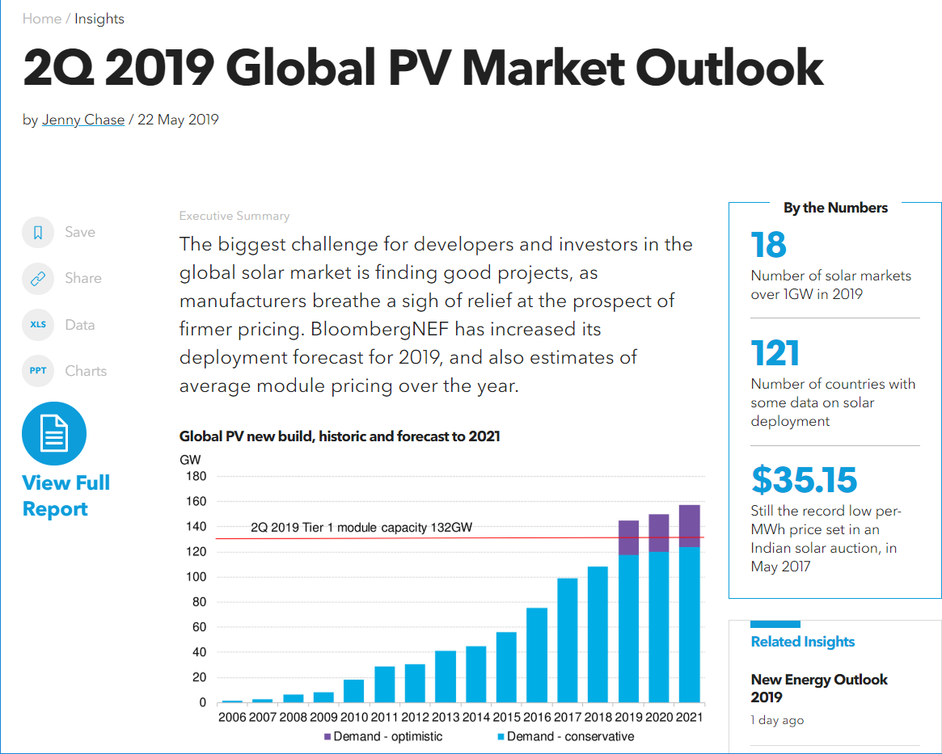
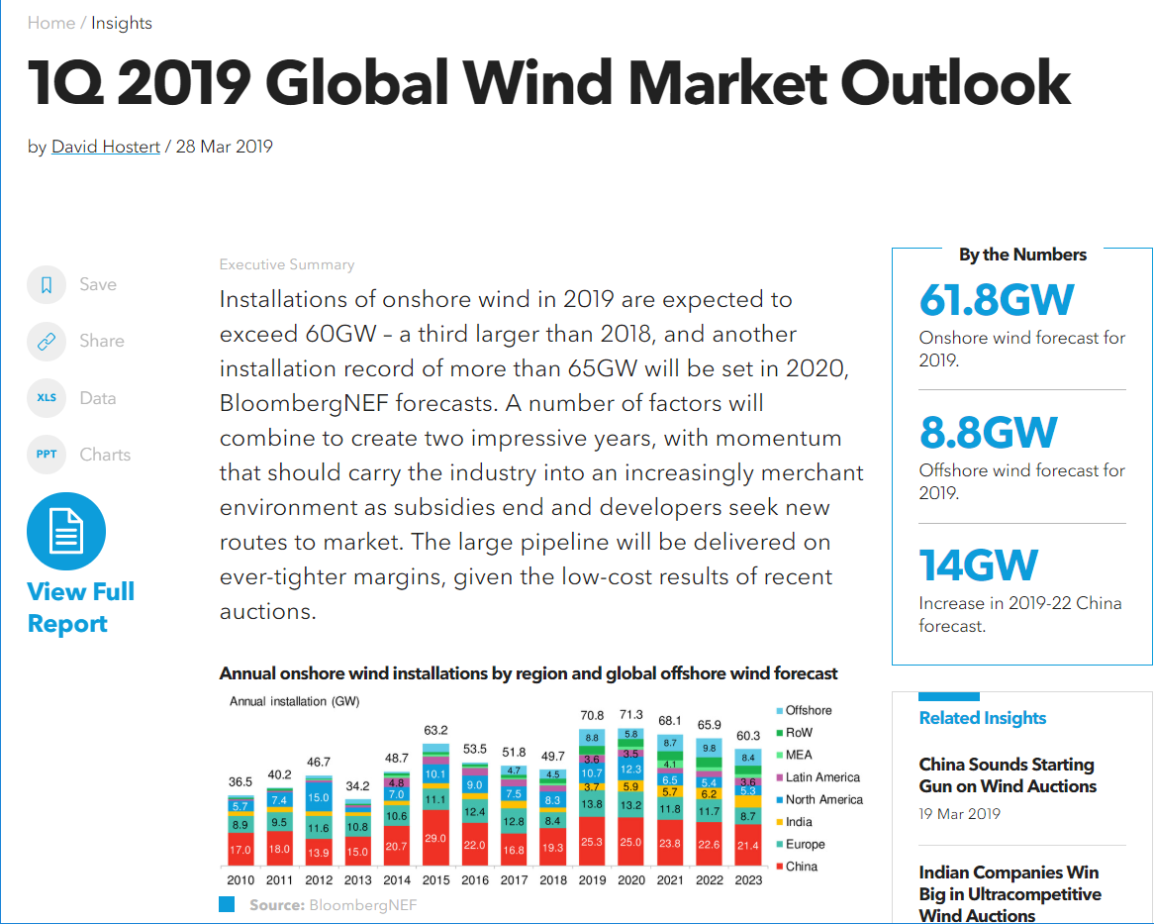
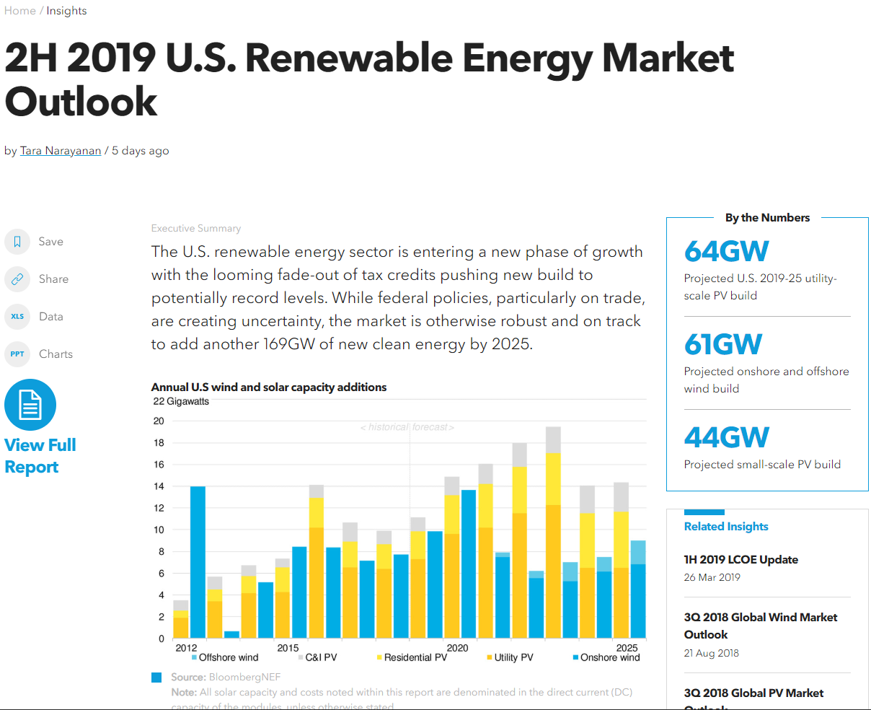
Sector and regional market outlooks

Slide 5
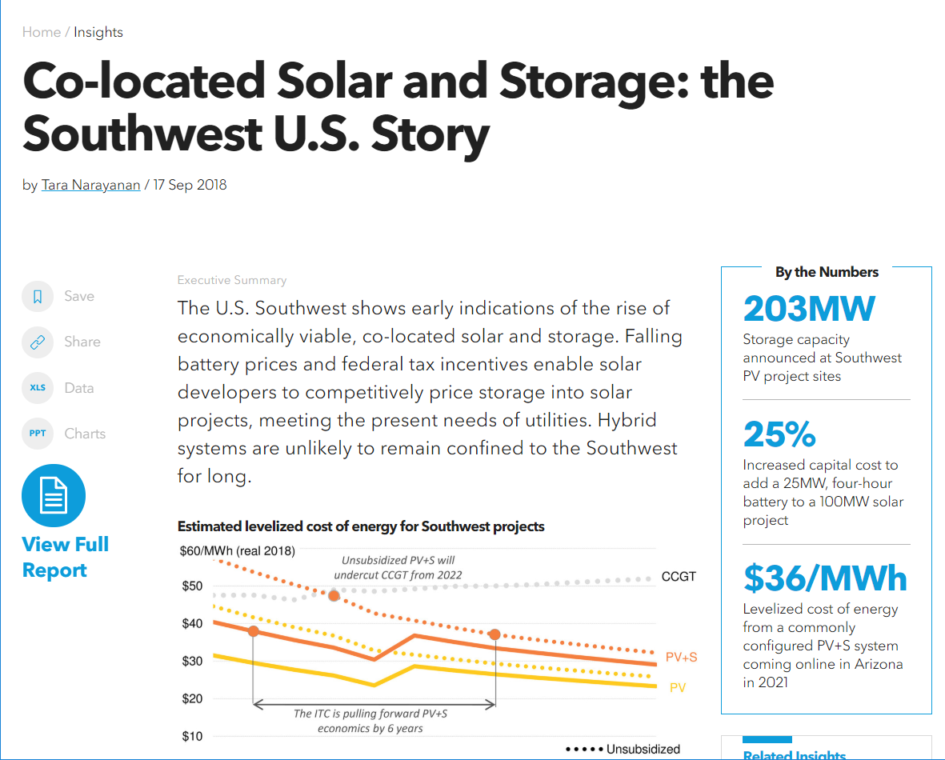
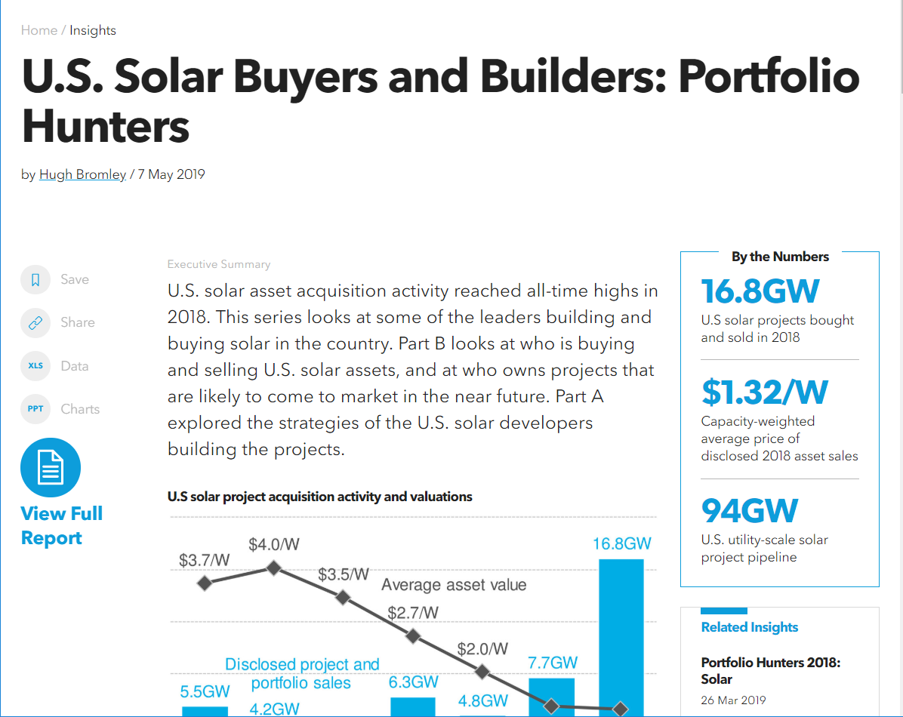
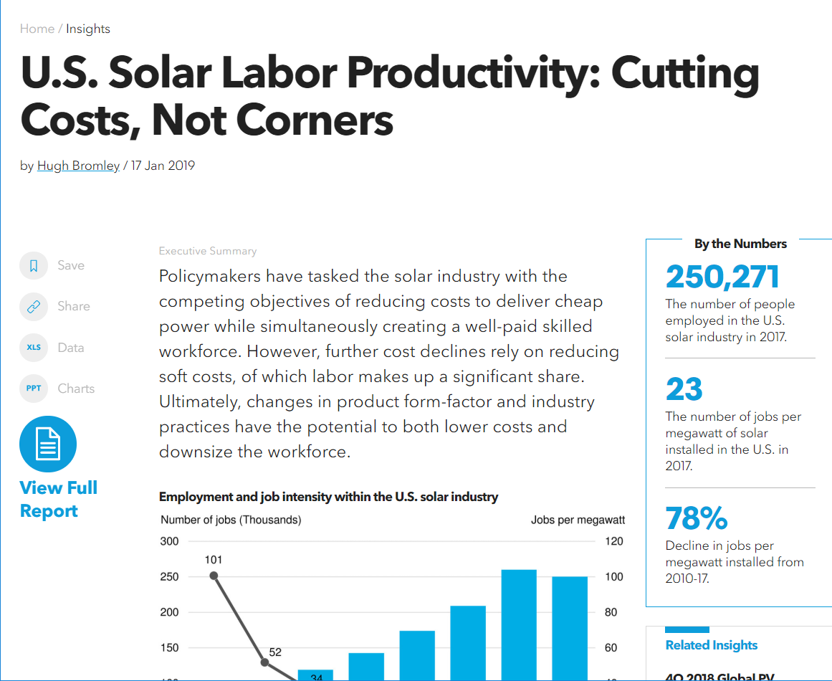
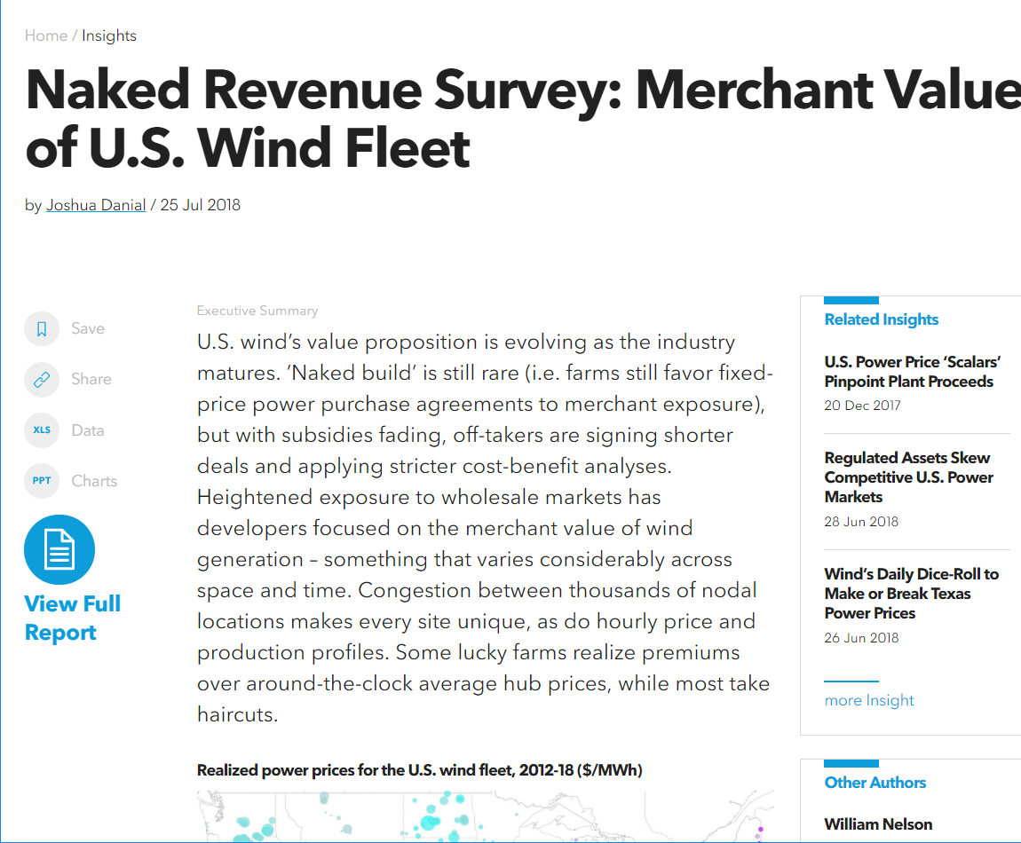
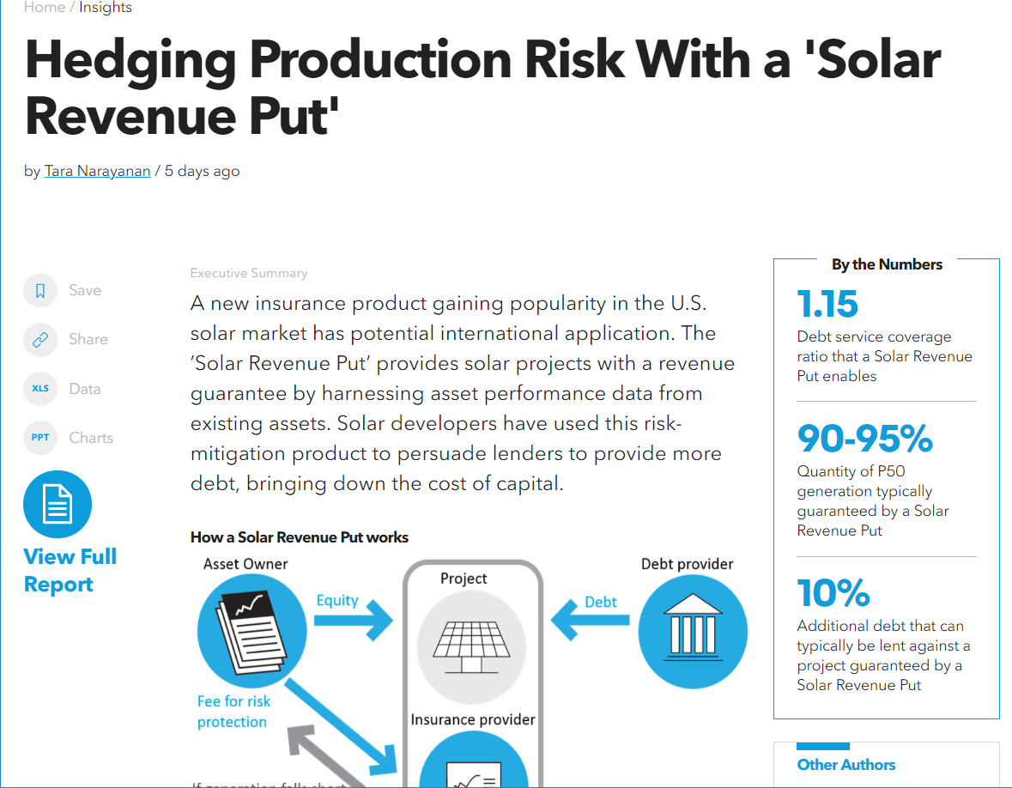
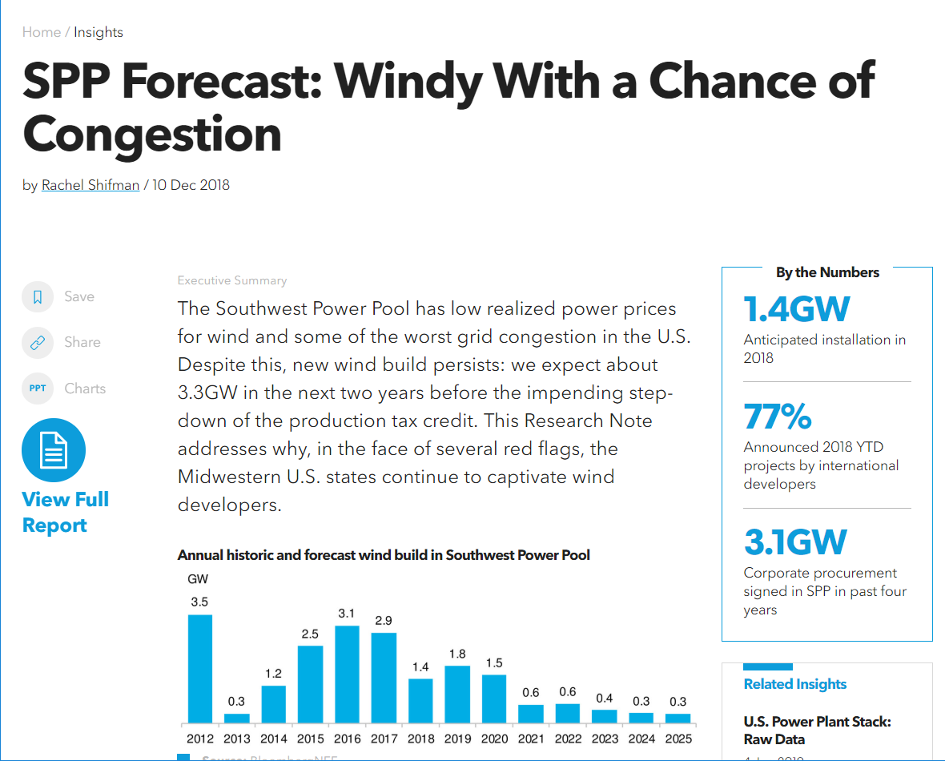
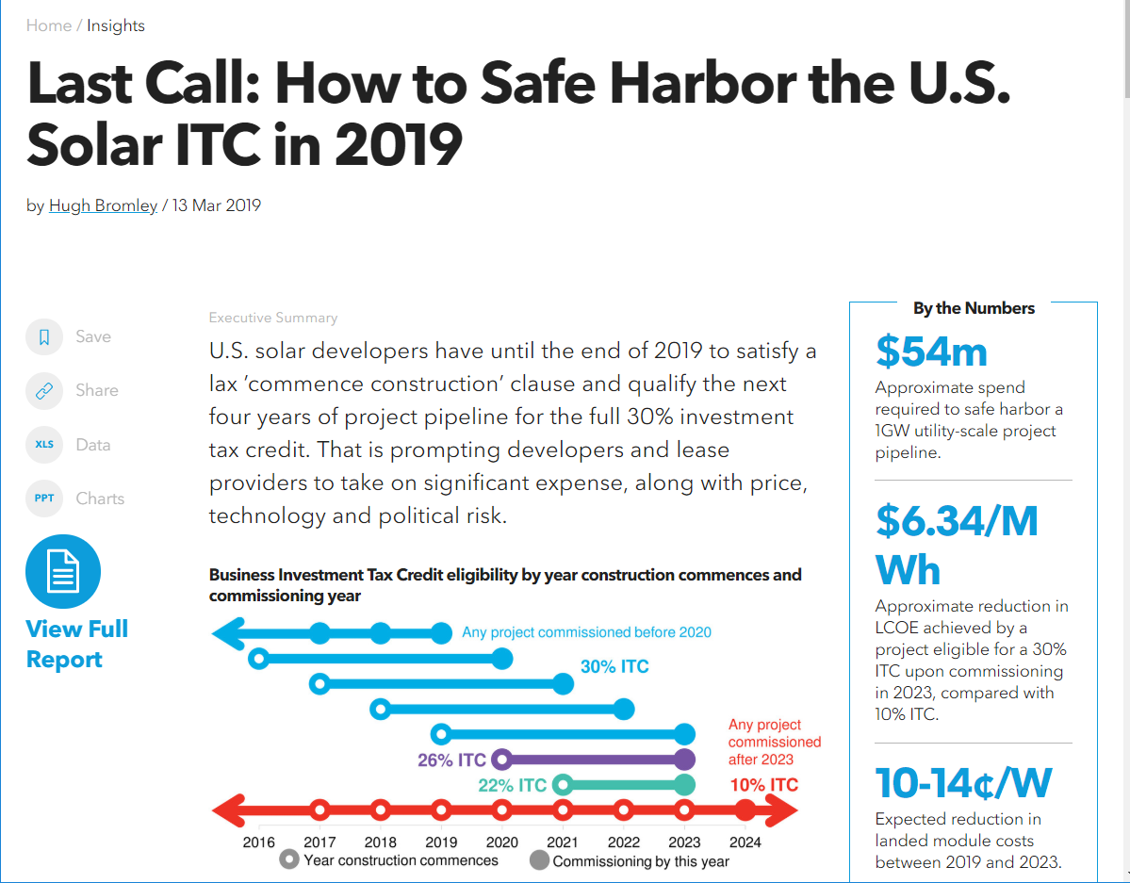
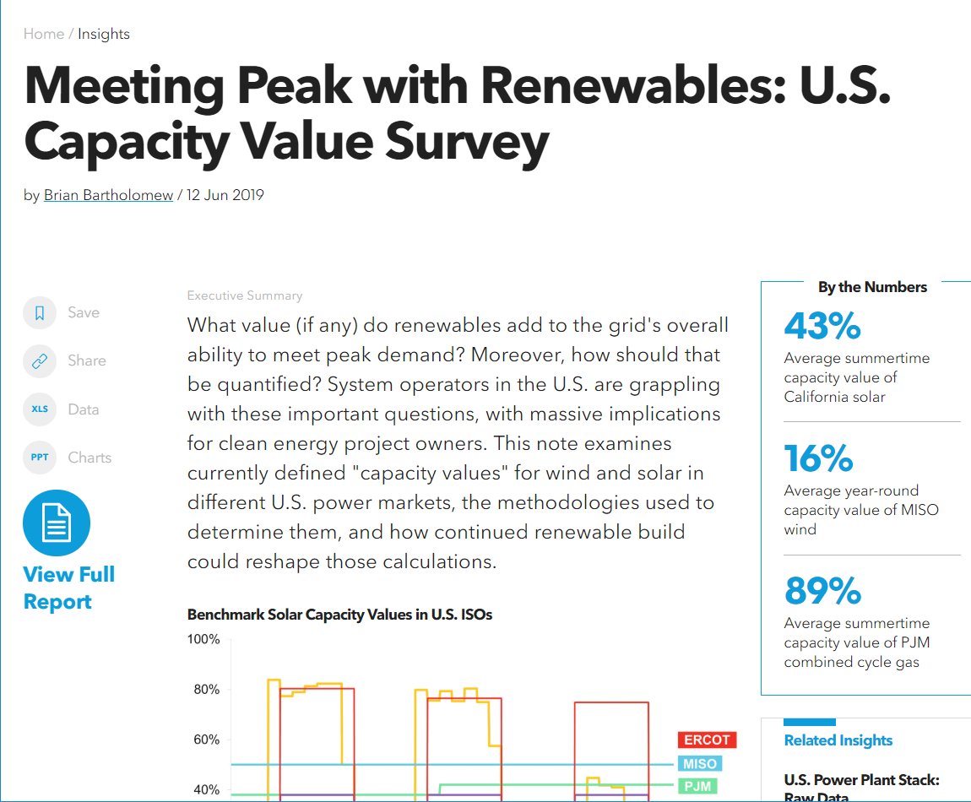
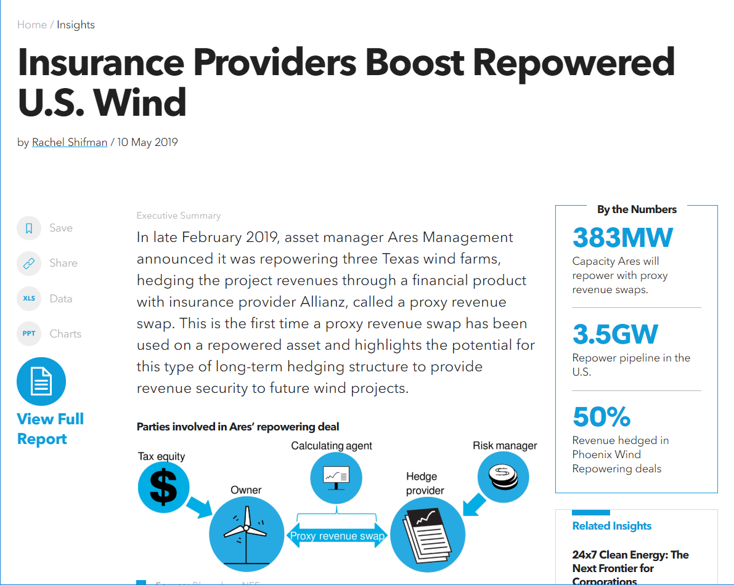
Industry research

Slide 6
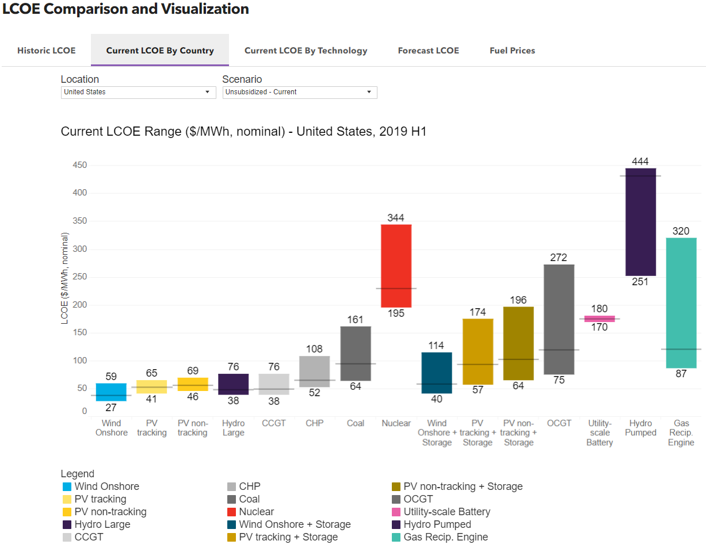
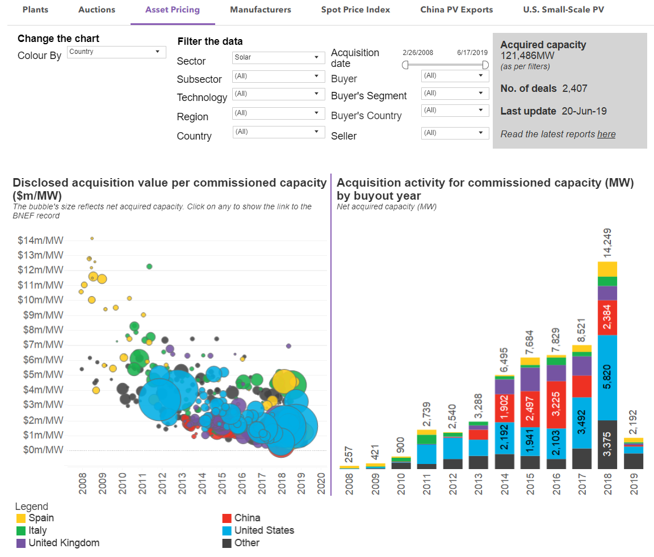
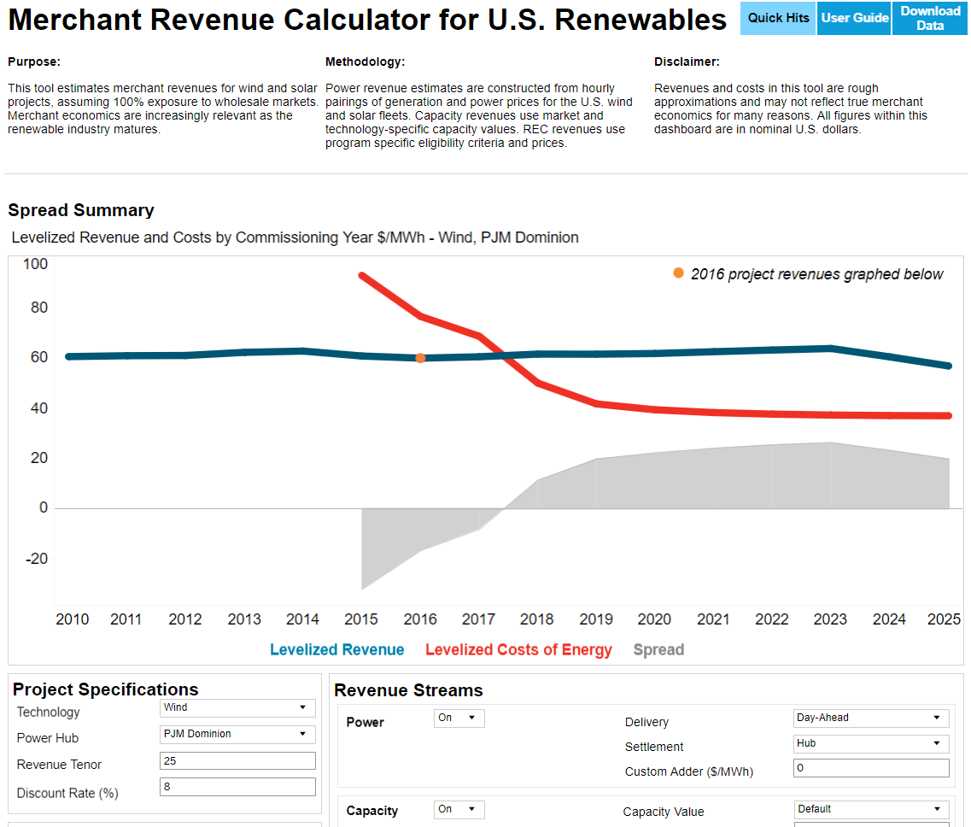
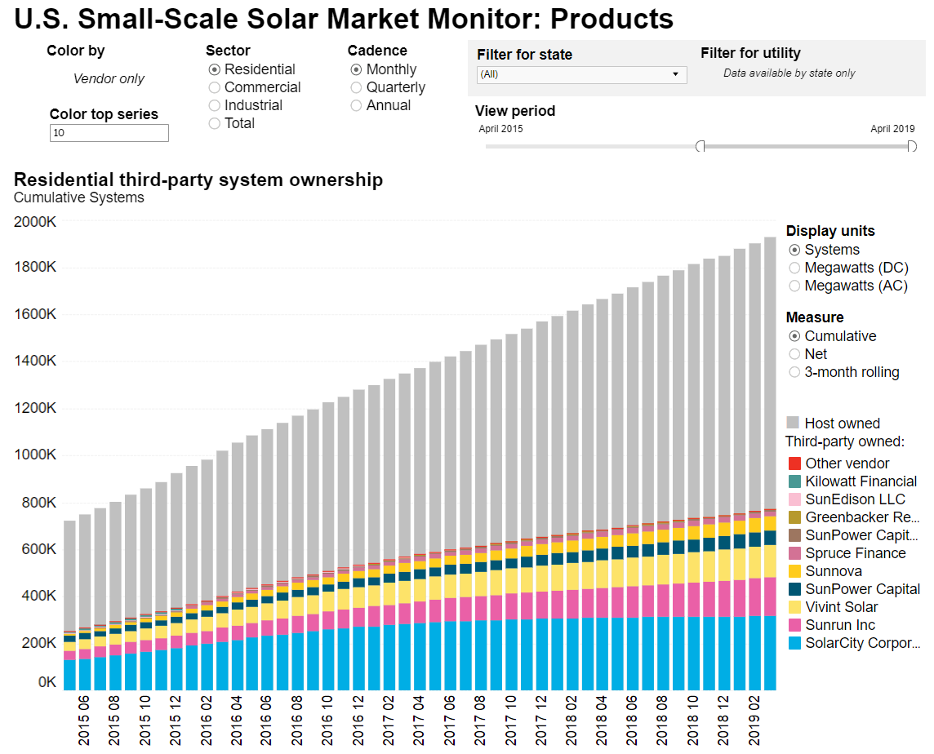
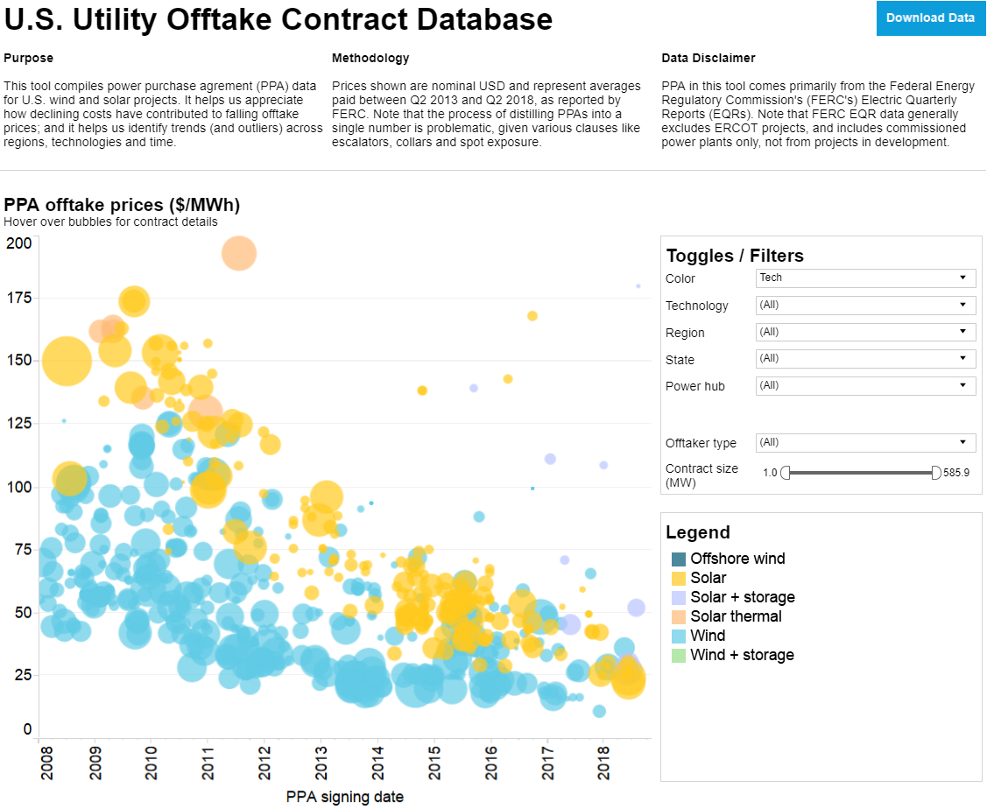
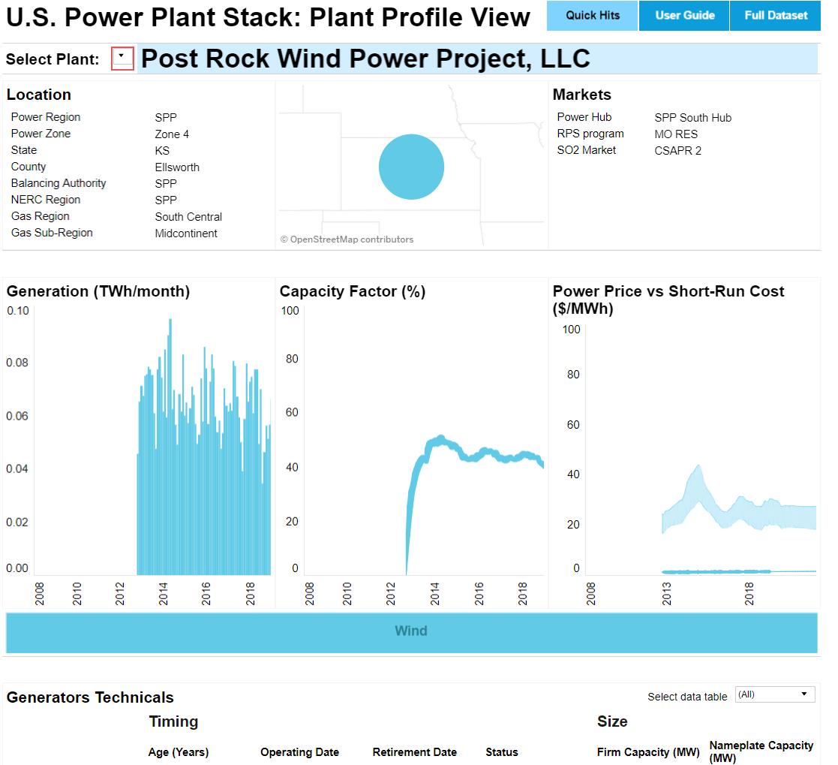
Data & tools

Slide 7
U.S. energy overview: Economy’s energy productivity
U.S. GDP and primary energy consumption
U.S. energy productivity
Source: Bureau of Economic Analysis, EIA, Lawrence Berkeley National Laboratory, BNEF Notes: Values for 2018 are projected, accounting for seasonality, based on latest monthly values from EIA (data available through October 2018). 2018 GDP estimate is a projection from economists compiled at ECFC <GO> on the Bloomberg Terminal.

Slide 8
U.S. energy overview: Primary energy consumption by sector
Source: EIA, BNEF Notes: Values for 2018 are projected, accounting for seasonality, based on latest monthly values from EIA (data available through September 2018)

Slide 9
U.S. energy overview: Energy and electricity consumption
U.S. primary energy consumption by fuel type
U.S. electricity demand
Source: EIA, BNEF Notes: “CAGR” on the right hand side graph is compound annual growth rate. Values for 2018 are projected, accounting for seasonality, based on the latest monthly values from EIA (data available through September 2018). BTU stands for British thermal units.

Slide 10
U.S. energy overview: Electricity generation mix
U.S. electricity generation by fuel type (%)
U.S. electricity generation by fuel type (TWh)

Slide 11
Electricity generation, U.S.
New Energy Outlook 2019
Source: BloombergNEF
Notes:
In contrast the US has cheap gas that expands continuously to 2050.
Coal and nuclear decline to 3.3% of electricity in 2050.
W & S also grow…to 35% of generation up from 9% today.

Slide 12
U.S. energy overview: Completed and announced coal-fired plant retirements
Source: EIA, company announcements, BloombergNEF Notes: “Retirements” does not include conversions from coal to natural gas or biomass; includes retirements or announced retirements reported to the EIA through October 2018. All capacity figures represent summer generating capacity.

Slide 13
U.S. energy overview: Electric generating capacity build by fuel type
Source: EIA, BloombergNEF Note: All values are shown in AC except solar, which is included as DC capacity. “Renewables” here does not include hydro, which is shown separately. All capacity figures represent summer generating capacity. Includes installations or planned installations reported to the EIA through October 2018, as well as BNEF projections.
Notes:
Gas turbine manufacturers advertise efficiencies over 62% (heat rate = 5.50MMBtu/MWh), but such figures are realized only under test conditions. In reality, the average combine-cycle gas turbine ran at 44% (7.75MMBtu/MWh) in 2017. Advances in turbine technology are allowing a new crop of hefty and efficient gas-fired power plants to outperform their peers. For example, the latest generation and fuel burn data compiled in Bloomberg NEF’s U.S. Power Plant Stack shows that two new 870-megawatt plants owned by Panda Power Funds recorded efficiencies above 50% (6.82MMBtu/MWh) in 2017.
BNEF expects the U.S. natural gas Henry Hub price benchmark to average between $2.50 and $3.50 per million British Thermal Units (MMBtu) in 2019, depending on how weather compares to normal. Once again, rising demand in the South is expected to be met by stronger production in the Northeast.
2018 was a year of unlocking more natural gas volumes from the Appalachian basin bound to the Midwest. The upstream impact was higher prices for the basin, which will support further production growth in 2019. The downstream impact was cheaper prices in the Midwest and a stronger competitive advantage for natural gas in that historically coal-heavy electricity-producing region. This penetration of natural gas in the Midwest will continue in 2019.
In the South, West Texas Permian production will remain constrained as new midstream capacity to take gas to the Gulf Coast will likely not come online until 2020. Weak gas prices should therefore prevail in West Texas for 2019. However, I expect exports from the Gulf to benefit from three new additions: 1) a second liquefaction train at the Corpus Christi LNG terminal, 2) the commissioning of three other new LNG export facilities, and 3) the completion of a 2.6 Bcfd underwater pipeline to export gas to Mexico.

Slide 14
U.S. energy overview: Renewable energy capacity build by technology
Source: BloombergNEF, EIA Notes: All values are shown in AC except solar, which is included as DC capacity. Numbers include utility-scale (>1MW) projects of all types, rooftop solar, and small- and medium-sized wind. Includes installations or planned installations reported to the EIA through October 2018, as well as BNEF projections.

Slide 15
U.S. energy overview: Electricity generation mix
U.S. electricity generation by fuel type (%)
U.S. renewable generation by technology
Source: BloombergNEF, EIA Notes: All values are shown in AC except solar, which is included as DC capacity. Hydropower capacity and generation exclude pumped storage facilities (unlike in past Factbooks). Totals may not sum due to rounding. Values for 2018 are projected, accounting for seasonality, based on latest monthly values from EIA (data available through October 2018)

Slide 16
U.S. energy overview: Jobs in select segments of the energy sector
Jobs in select energy segments, 2017
Sustainable energy jobs, 2017
Source: The U.S. Energy Employment Report, NASEO and EFI. Notes: The data provided relies on thousands of data points provided via survey. Transmission, distribution, and oil/petroleum jobs not included as available data does not break out the portion of those jobs relevant to the electricity sector. See footnote on next slide for details on the definition for “Advanced Gas.”

Slide 17
U.S. energy overview: Jobs in electricity generation
2017
2016
Source: The U.S. Energy Employment Report, NASEO and EFI. Notes: 2016 data is from Q1 2016, 2017 data is from 2Q 2017. “Advanced gas” uses a variety of technologies including high efficiency compressor systems, advanced low NOx combustion technology, first application of closed loop steam cooling in an industrial gas turbine, advanced turbine blade and vane materials, high temperature tbc and abradable coatings, advanced row 4 turbine blades, 3-d aero technology, or advanced brush seal.

Slide 18
Average efficiency of surveyed manufacturers, 2018
Clean energy technology and cost outlook
Cell
Module
Mono c-Si Multi c-Si
Source: BloombergNEF

Slide 19
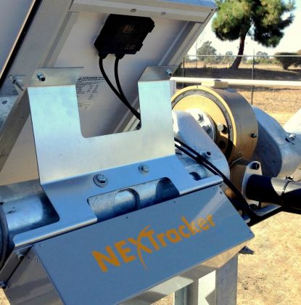
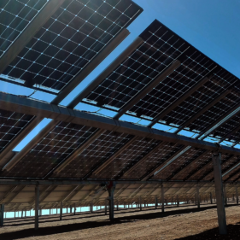
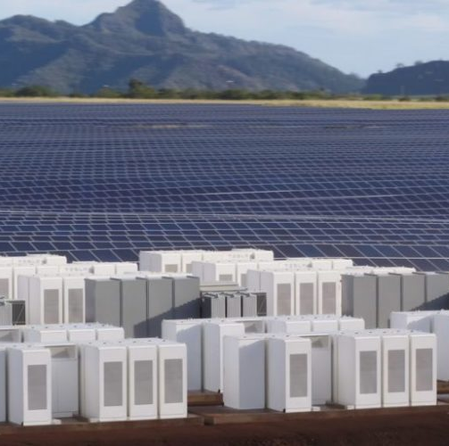
Technology trends start in the U.S.
Clean energy technology and cost outlook
Tracking
Bifacial modules
Solar + storage

Slide 20
U.S. energy overview: Greenhouse gas (GHG) emissions
Economy-wide and energy sector emissions
Emissions by sector
Source: BloombergNEF, EIA, EPA Inventory of U.S. Greenhouse Gas Emissions and Sinks: 1990-2016 Notes: “Sinks” refer to forests and green areas which absorb carbon dioxide. Values for 2018 are projected, accounting for seasonality, based on monthly values from EIA available through September 2018.

Slide 21
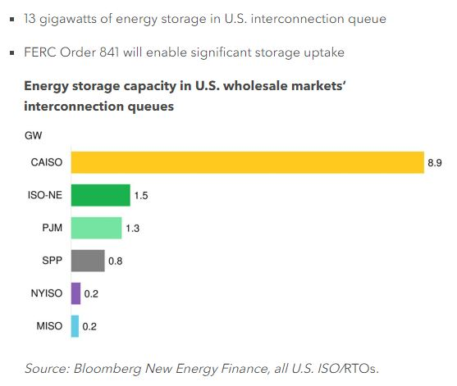
Battery Storage and You!

Slide 22
Lithium-ion battery prices keep falling
Electric Vehicle Outlook 2019
Source: BloombergNEF
Notes:
In December 2018, BloombergNEF published the results of its ninth Battery Price Survey, a series that begin in 2012 looking back at data from as early as 2010. The annual price survey has become an important benchmark in the industry and the fall in prices has been nothing short of remarkable: the volume weighted average battery pack fell 85% from 2010-18, reaching an average of $176/kWh.

Slide 23
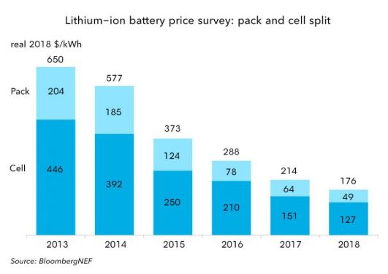
Addressing Li-ion battery (mis)conceptions
“Current prices are far lower than this in reality” and “Current prices are far higher than this in reality”
Notes:
Partially true: wide range of battery types in the market and anecdotes do not make a market
Volume-weighted pricing (take Tesla for example)
Some people also incorrectly compare cell and pack costs
In general, that we hear both too high and too low makes us believe that our number might be closer to the market reality.
Regarding higher prices, companies often sigh with disbelief as they are unable to secure the prices we’ve disclosed. While unfortunate for them, they do not have the clout of a Volkswagen or Nissan when it comes to negotiations. There are also good reasons why they may face higher prices: Vehicle type, design and the type of cooling will all have a large impact. For example, the requirements of a battery in a heavy-duty vehicle are likely to be quite different to those in a small passenger electric vehicle, even if there are many commonalities between the two. Manufacturers may be willing to pay more for batteries with specific characteristics.

Slide 24
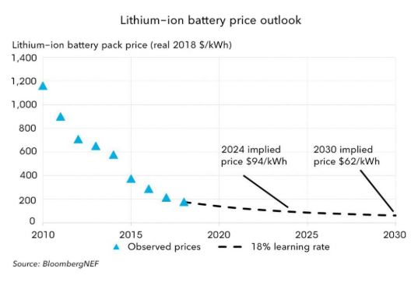
Addressing Li-ion battery (mis)conceptions cont’d
“Batteries will fall much faster than you are forecasting”

Slide 25
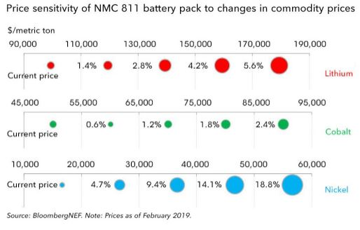
Addressing Li-ion battery (mis)conceptions cont’d
“Battery prices are increasing, not falling”

Slide 26
Addressing Li-ion battery (mis)conceptions cont’d
“What comes after lithium-ion?”
Excitement over solid-state batteries, graphene anodes and ultra-fast charging
4-5 years for commercialization of new tech
Don’t expect solid-state batteries to meaningfully impact global EV market until late 2020s.

Slide 27
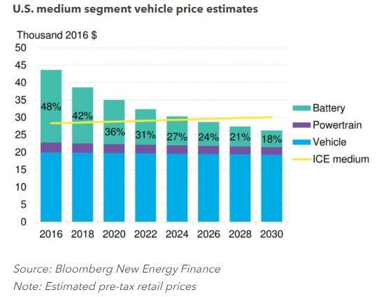
EVs reach price parity in the mid 2020s
Electric Vehicle Outlook 2019
Source: BloombergNEF

Slide 28
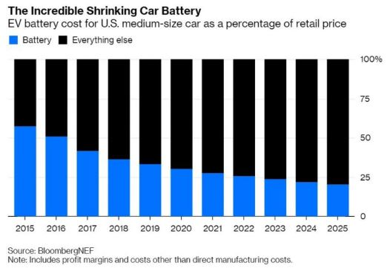
Parity driven by shrinking prices

Slide 29
EVs as future demand driver
U.S. Renewable Energy Market Outlook
Global electricity demand from transport
Impact on U.S. electricity demand
11% by 2040
Source: BloombergNEF
Notes:
EV will not save you in the mid-term
Electric pickup trucks open a largely unaddressed market in the US
We forecast 11% elec consumption in the US in 2040 from electric road tansport

Slide 30
There is no shortage of feasible projects
U.S. Renewable Energy Market Outlook
BNEF U.S. solar pipeline by known or developer-expected commissioning date
BNEF U.S. wind pipeline by known or developer-expected commissioning date
Source: BloombergNEF – Renewable Project Database (as of June 17, 2019)

Slide 31
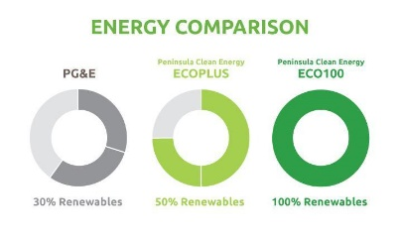
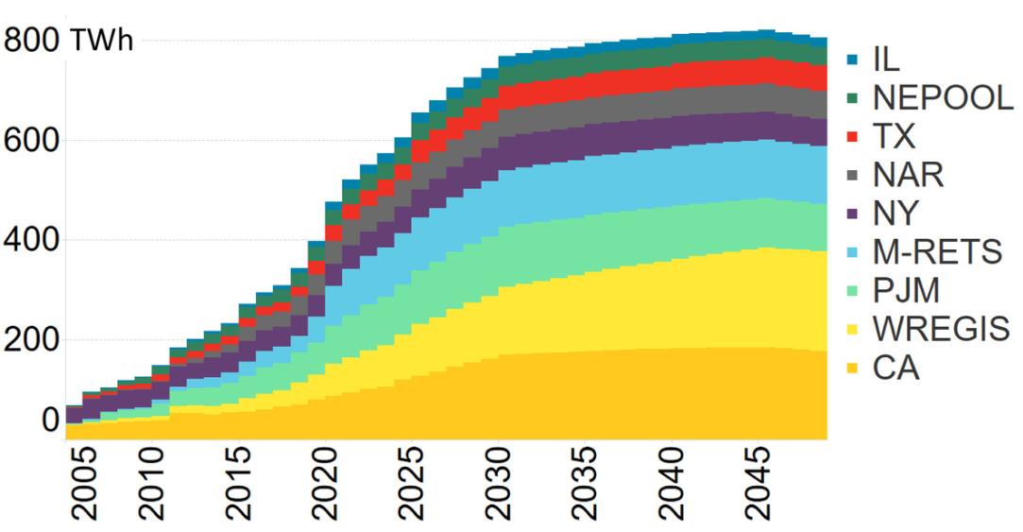
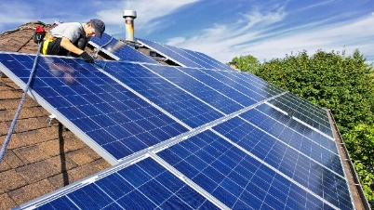

Policy demand has been rekindled across much of the country
U.S. Renewable Energy Market Outlook
U.S. RPS demand by region, 2005-2050
Example: California’s expanded framework
AB 117 & SB 790:
Enabling Community Choice Aggregation
Title 24, Part 6, Building Energy Efficiency Standards:
Residential solar mandate
SB 100: 100% clean energy target
Source: BloombergNEF (U.S. Renewable Portfolio Standard Demand Dataset)
Note: Includes both mandatory and voluntary state and utility targets

Slide 32
Copyright and disclaimer

